Slide 1
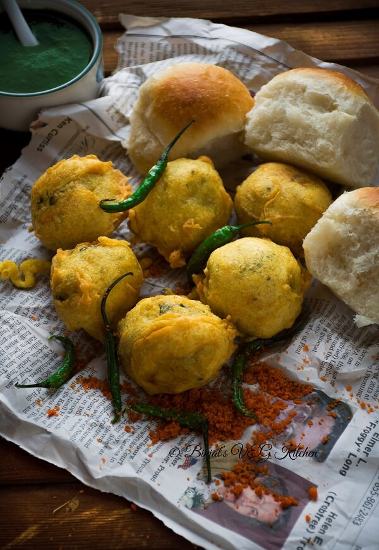
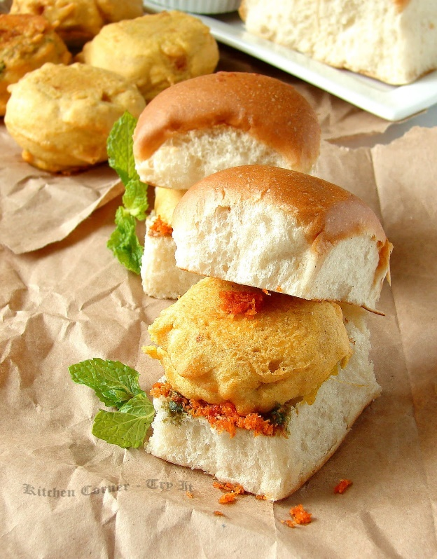
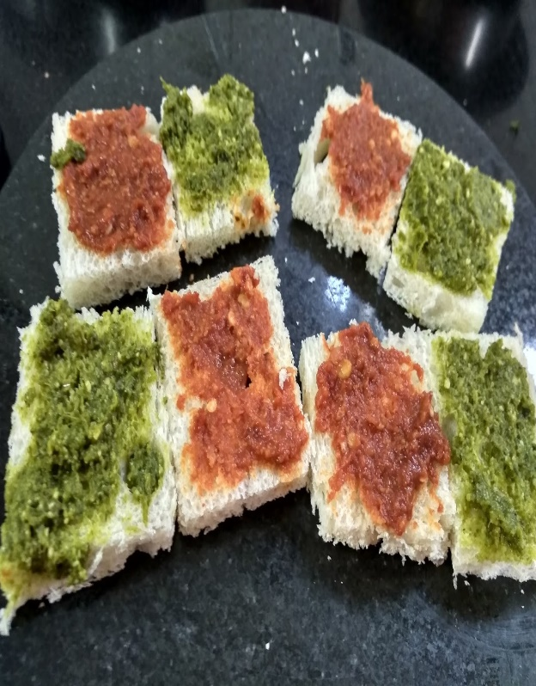
Case Study - WadaPav
Location: Shivaji Nagar, Pune
Notes:
NOTE: To replace a picture, just select and delete it. Then use the Insert Picture icon to replace it with one of your own!

Slide 2
Agenda
Introduction
Pricing Strategy
Differentiation Strategy
Gathering Insights
Positioning and value proposition
Solution Description
Impact

Slide 3
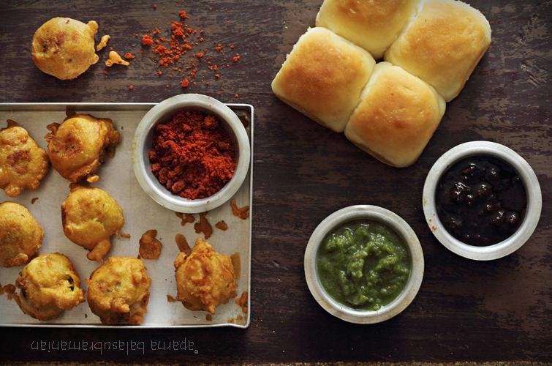
Introduction
Wada Pav is a popular street food in India, it is a savory and spicy soft dinner rolls or fluffy buns, referred to as Pav, stuffed with a fried batter coated potato dumpling fritter called Batata Wada and laced with spicy and sweet chutneys
Starting a Wada pav outlet does not involve much investment and the government licensing fee is also very nominal. Raw materials are easily available.
In case the business does not perform well, switching cost is also very small
Wada Pav is not only a beloved street food but also holds cultural significance, reflecting the fast-paced lifestyle of Mumbai and the blend of flavors that the city is known for.
It's an affordable and accessible option for a quick bite, making it a staple in the street food scene of India.

Slide 4
Pricing and Differentiation Strategy
Pricing
Calculate the cost of ingredients, labor, overheads, and other operational expenses.
Competition: Analyze the pricing of the existing Wada Pav shops in the area to offer a competitive rate.
Set a price that reflects the quality, taste, and experience customers will receive.

Slide 5
Price

Slide 6
Differentiation Strategy
Variety
Branding
Quality
Presentation
Service
Delivery
Zomato
Swiggy
Dunzo
Food Panda
Payment Type
Cash
BHIM
UPI
G-Pay
Phonepay
Outdoor Seating
Home Delivery
Serves Non veg
Service Amenities
Instagram
Facebook
Just dial
Food Blog
Social Media Marketing

Slide 7
Gathering Insight
Name | Years of Business | Rating ( /5*) | Timing | Service | Food | Value of money
Gajanan Wada Pav | 45 years | 4.1 | 9Am to 10 Pm | Good | 4 | 3.8
Joshi Wadewale | 34 years | 4.0 | 9:00 am - 10:30 pm | Good | 3.9 | 4
Prabha Vishranti Gruha | 83 years | 4.3 | 8:30 am - 12:00 pm 4:30 pm - 8:30 pm | Good | 4.2 | 4.2
Asha Fast Food | 30 years | 4.1 | 6:00 am - 10:30 pm | Good | 3.9 | 4
Kasturi Apopahar | 5 years | 4.4 | 8:00 am – 10:30 pm | Good/ Home Delivery | 4.2 | 4.1
Bhau Wada Pav | 51 years | 4.3 | 9:00 am - 9:30 pm | Good | 4.1 | 4

Slide 8
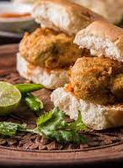
Positioning and Value Proposition:
Quality and Authenticity
Local Flavor and Tradition
Innovation
Quick service - no waiting period
Convenient position for the shop
Positioning involves defining the unique place your Wada Pav shop holds in the minds of your target customers. It's about identifying a distinct space in the market that sets you apart from competitors.

Slide 9
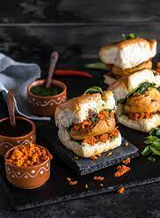
Affordable for everyone
Freshness and Taste
Varity and choices in taste
Emphasize efficient service
Local Legacy
Quick Pick me-up
Taste Sensation with every bite
The value proposition articulates the benefits and value that customers will receive by choosing your Wada Pav shop. It's the unique promise that encourages customers to visit and come back.

Slide 10
Business Impact
A successful Wada Pav business can serve as an example of local entrepreneurship, inspiring others to start their own ventures.
Business Impact enable businesses to make decisions based on real-time, accurate, and relevant data, which can lead to more informed choices and improved ROI.
BI can help you monitor the performance of other Wada Pav shops in the area. This allows you to assess your own performance in comparison and make necessary adjustments to stay competitive
By identify cost patterns, such as excessive wastage or overstocking, investor can make adjustments to reduce costs and improve profitability.
To gather the real-time insights into your sales performance. You can track sales trends, peak hours, and slow periods, enabling you to adjust staffing levels and inventory accordingly.

Slide 11
Solutions for Growth
Introduce unique variations of Wada Pav that aren't offered by competitors, such as fusion flavors or healthier options.
Establish a strong social media presence to showcase the shop's offerings, engage with customers, and share updates about promotions or new items.
Run loyalty programs, discounts, and special offers to incentivize repeat visits.
Partner with nearby businesses, offices, and events for catering or special promotions.
Participate in local events, collaborate with local influencers, and engage in community initiatives to build a strong local presence.
Focus on maintaining consistent taste, quality, and service to build customer trust and loyalty.

Slide 12

By K.Swency Batch-88

